Slide 1
Accessibility Comparisions
Yunguo Cai
12/04/2017

Slide 2
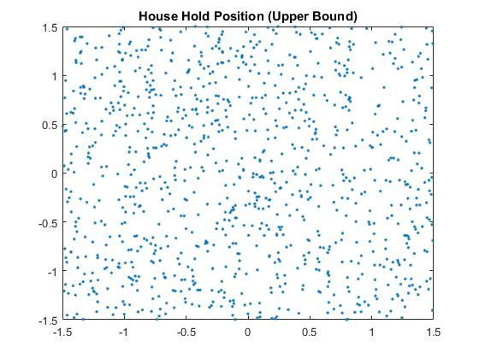
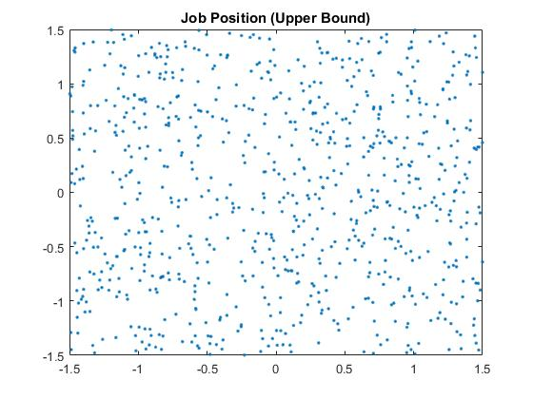
Location Comparison – Upper Bound
2

Slide 3
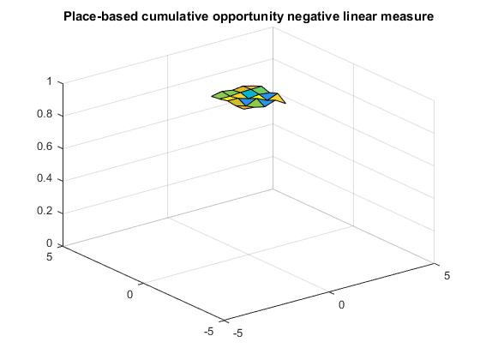
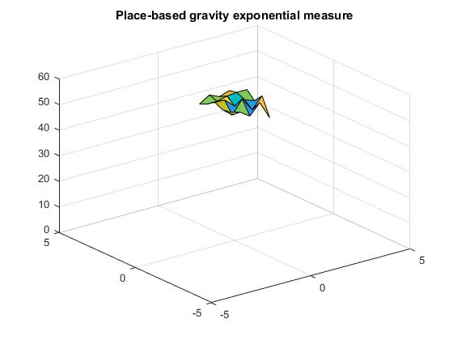
Location Comparison – Upper Bound
3

Slide 4
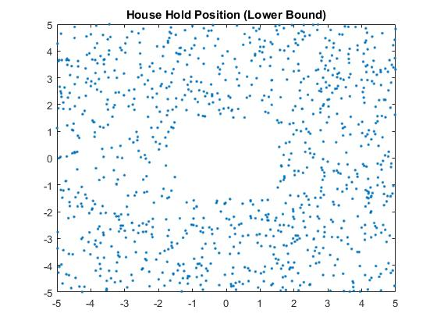
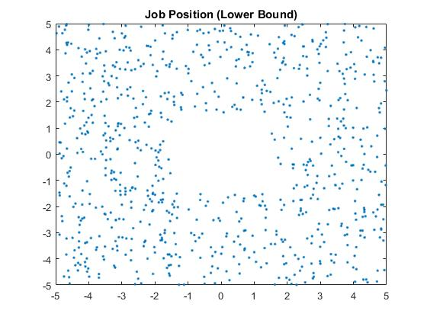
Location Comparison – Lower Bound
4

Slide 5
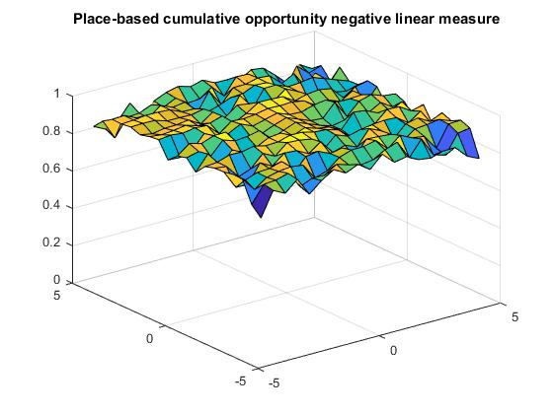
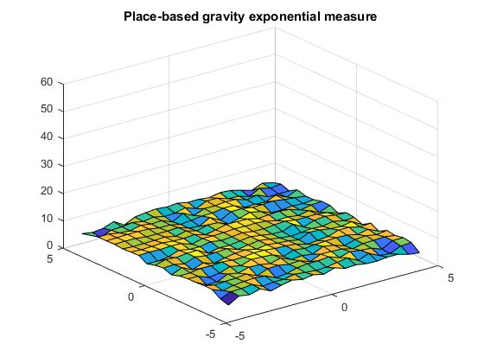
Location Comparison – Lower Bound
5

Slide 6
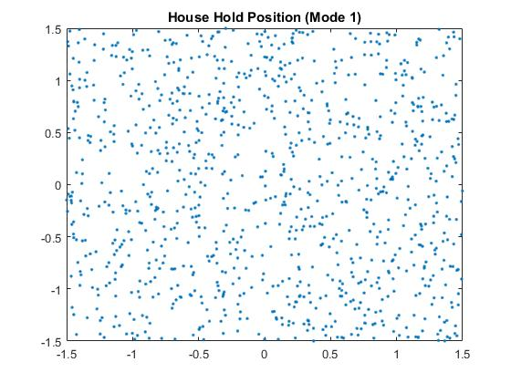
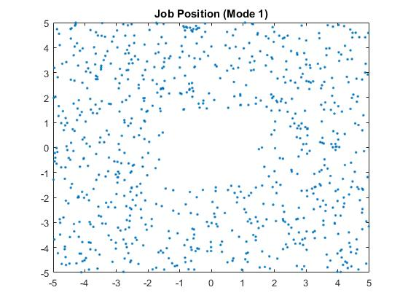
Location Comparison – Mode 1
6

Slide 7
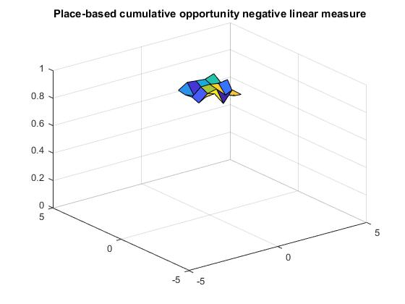
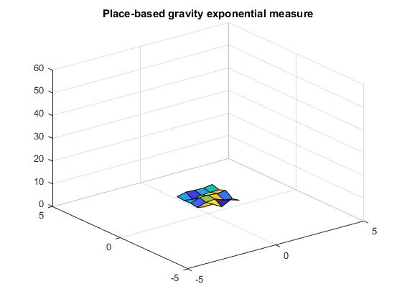
Location Comparison – Mode 1
7

Slide 8
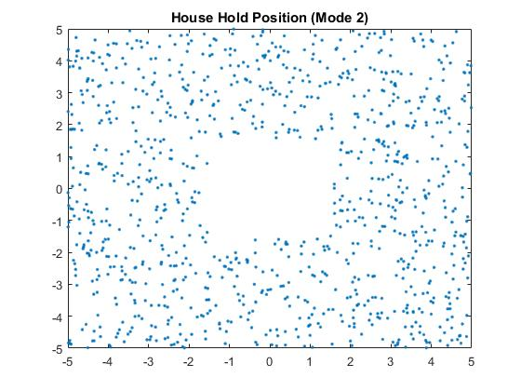
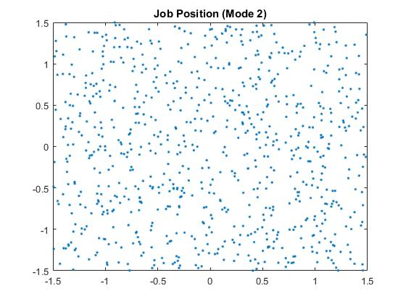
Location Comparison – Mode 2
8

Slide 9
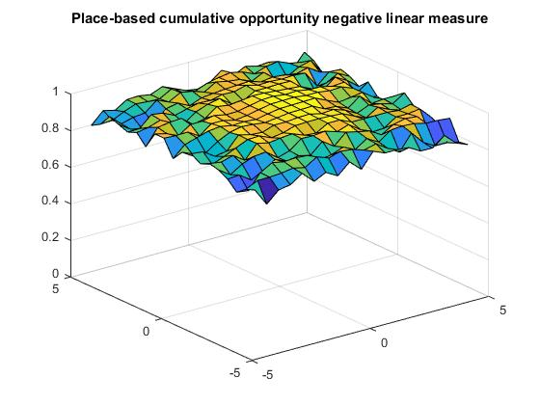
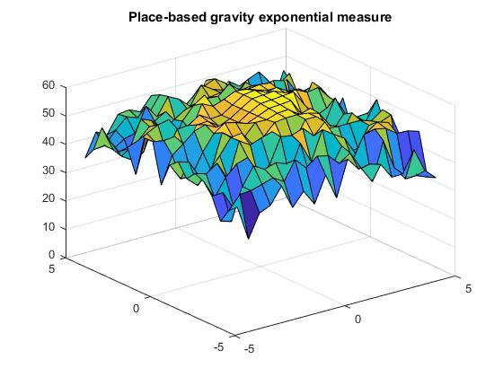
Location Comparison – Mode 2
9

Slide 10
Results Comparisons
10
 | Upper Bound | Lower Bound | Mode 1 | Mode 2
Gravity Measure | 57.1339 | 6.9289 | 6.9426 | 47.3816
Percentage difference (relative to lower bound) | 725% | 0 | 0.198% | 583.8%
Cumulative Opportunity | 0.9676 | 0.8862 | 0.9146 | 0.9144
Percentage difference (relative to lower bound) | 9.19% | 0 | 3.20% | 3.18%

Slide 11
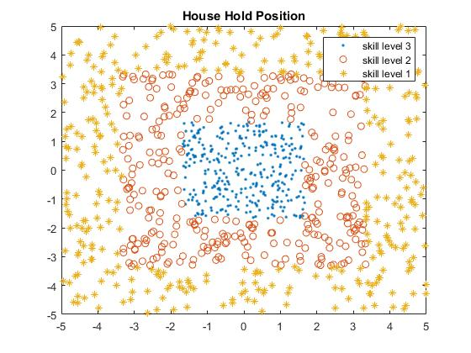
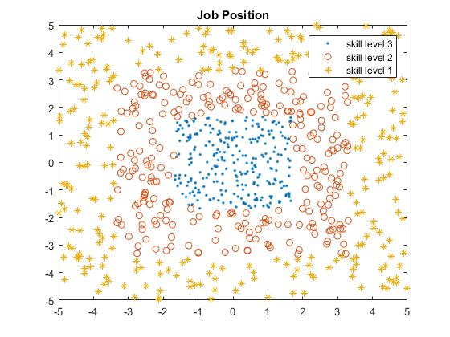
Density Comparison – Original Model
11

Slide 12
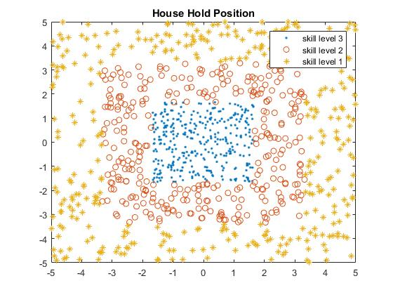
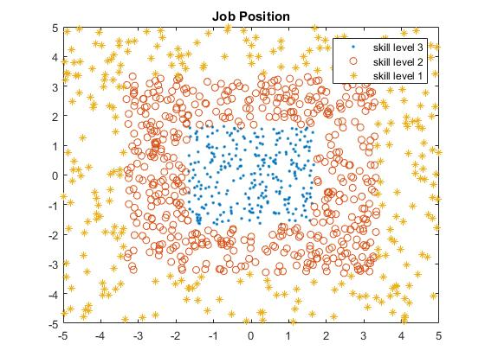
Density Comparison – Double Skill Level 2
12

Slide 13
Results Comparisons
13
 | Original Model | Double Skill Level 1 Job | Double Skill Level 2 Job | Double Skill Level 3 Job | Triple Skill Level 1 Job | Triple Skill Level 2 Job | Triple Skill Level 3 Job
Gravity Measure | 5.0368 | 8.5879 | 9.3539 | 12.2079 | 10.9541 | 11.9638 | 16.6041
Percentage difference | 0 | 70.5% | 85.7% | 142.4% | 117.5% | 137.5% | 229.7%
Cumulative Opportunity | 0.6103 | 0.7275 | 0.6172 | 0.4948 | 0.7527 | 0.6184 | 0.4517
Percentage difference | 0 | 19.2% | 1.12% | -18.9% | 23.3% | 1.33% | -26.0%

Slide 14
Transportation mode comparison
14
Mode 1: all people drive to work.
Mode 2: all people walk to work.
Mode 3: skill level 3 drive, skill level 2 take bus, skill level 1 walk
Mode 4: skill level 3 drive, skill level 2 drive or take bus, skill level 1 walk

Slide 15
Results Comparisons
15
 | Small City |  |  |  | Large City
 | Mode 1 | Mode 2 | Mode 3 | Mode 4 | Mode 1 | Mode 2 | Mode 3 | Mode 4
Gravity Measure | 5.5399 | 3.9226 | 5.6510 | 5.0651 | 70.5867 | 50.8231 | 66.8895 | 61.4222
Percentage difference (Relative to mode 2) | 41.2% | 0 | 44.1% | 29.1% | 38.9% | 0 | 31.6% | 20.9%
Cumulative Opportunity | 0.6139 | 0.5469 | 0.6371 | 0.5913 | 0.6478 | 0.5721 | 0.6515 | 0.6167
Percentage difference (Relative to mode 2) | 12.3% | 0 | 16.5% | 8.12% | 13.2% | 0 | 13.9% | 7.81%

Slide 16
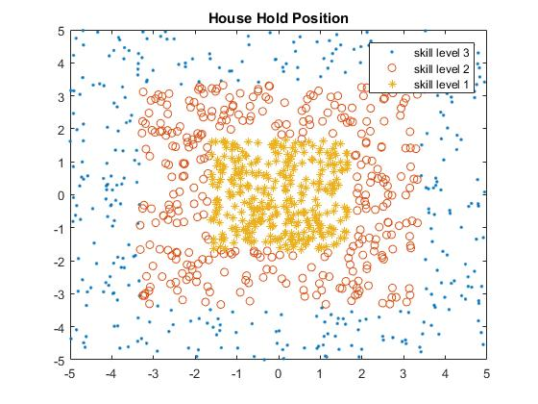
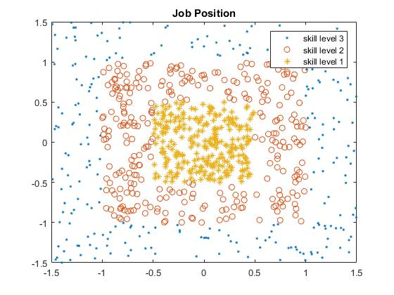
Skill level location Comparison – Model 1 Large City
16

Slide 17
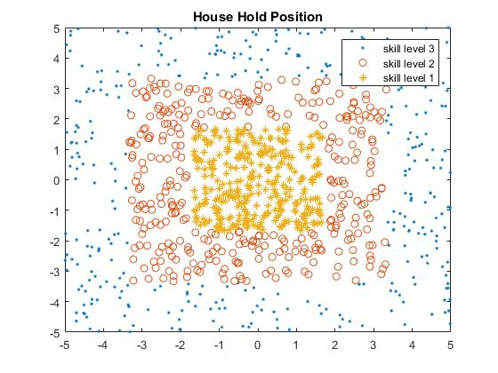
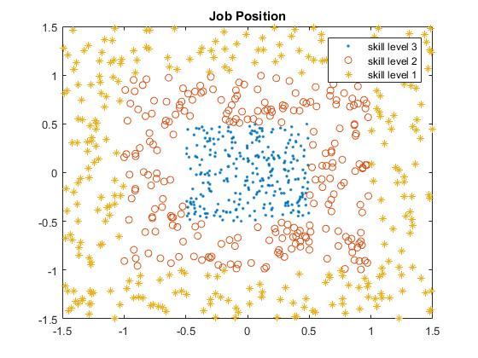
Skill level location Comparison – Model 2 Large City
17

Slide 18
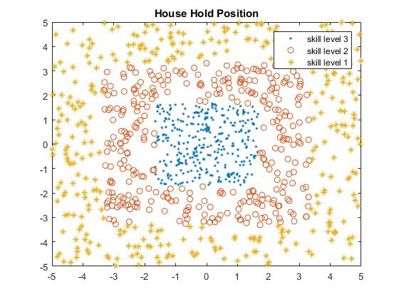
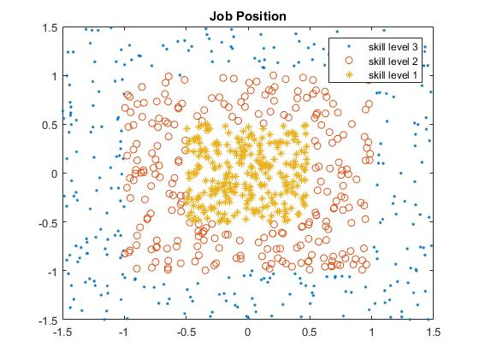
Skill level location Comparison – Model 3 Large City
18

Slide 19
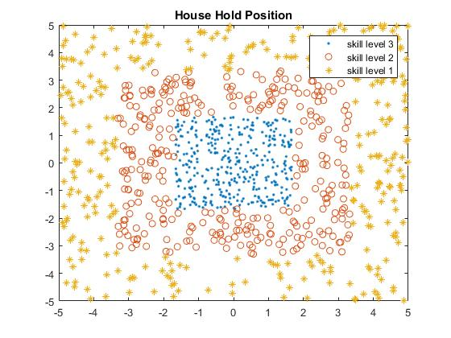
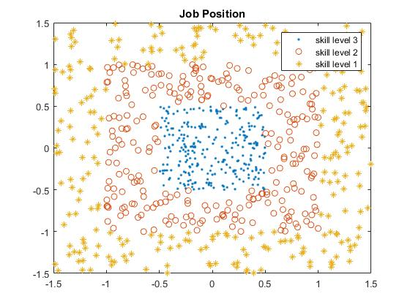
Skill level location Comparison – Model 4 Large City
19

Slide 20
Results Comparisons
20
 | Small City |  |  |  | Large City
 | Model 1 | Model 2 | Model 3 | Model 4 | Model 1 | Model 2 | Model 3 | Model 4
Gravity Measure | 5.4336 | 4.3636 | 5.2127 | 4.9305 | 65.6314 | 36.8858 | 61.1470 | 43.7995
Percentage difference (Relative to model 1) | 0 | -19.7% | -4.07% | -9.26% | 0 | -43.8% | -6.83% | -33.3%
Cumulative Opportunity | 0.6148 | 0.5989 | 0.5956 | 0.6189 | 0.6342 | 0.6186 | 0.6240 | 0.6156
Percentage difference (Relative to mode1 1) | 0 | -2.59% | -3.12% | 0.656% | 0 | -2.46% | -1.61% | -2.94%

